Slide 1
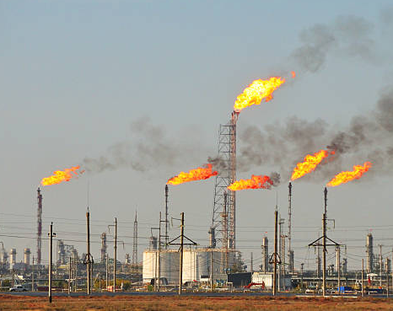
HPCL Project
Flare root cause identification

Slide 2

Outline
Database MariaDB – GUI to upload the plant data
Hierarchical PCA-based flare root cause identification (batch mode)
Hierarchical PCA-SFA-based flare root cause identification (batch mode)

Slide 3

Units of HPCL refinery
SEU1 , SEU2, SEU3– Solvent Extraction Unit
DIA – Diesel Iso Therming Unit
PDA – Propane De-Asphalting Unit
LOUP – Lube Oil Upgrading Plant
PG – Prime G
ISOM- Isomerization unit
ISOM2 – LPG Mounded Bullets
ISOM3- Propane and Vr LPG treating unit
ISOM4: Diesel hydrogen treating
PDU- Lube related process
CCR - Continuous Catalyst Regeneration
DAK – De-Aromatized Kerosene
CPP – Captive Power Plant
CDU – Crude Distillation Unit

Slide 4
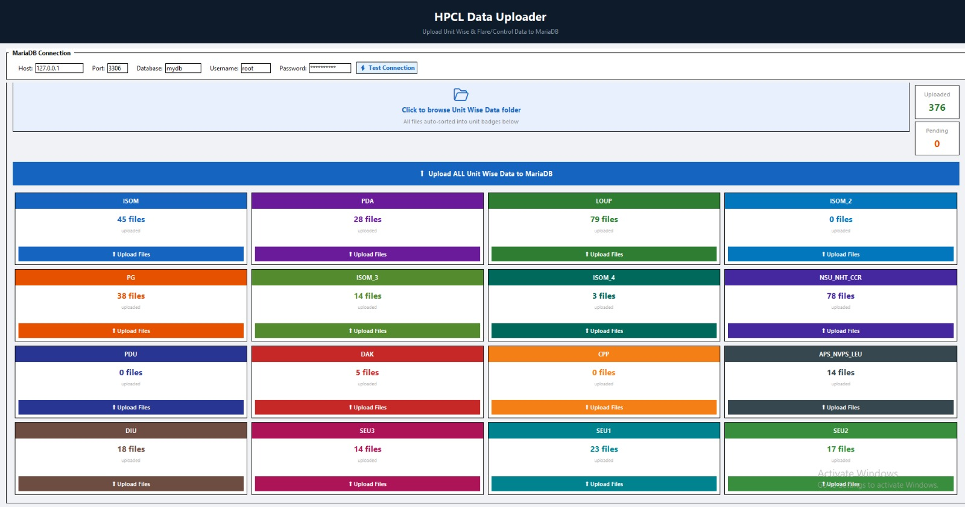
Database MariaDB – GUI

Slide 5
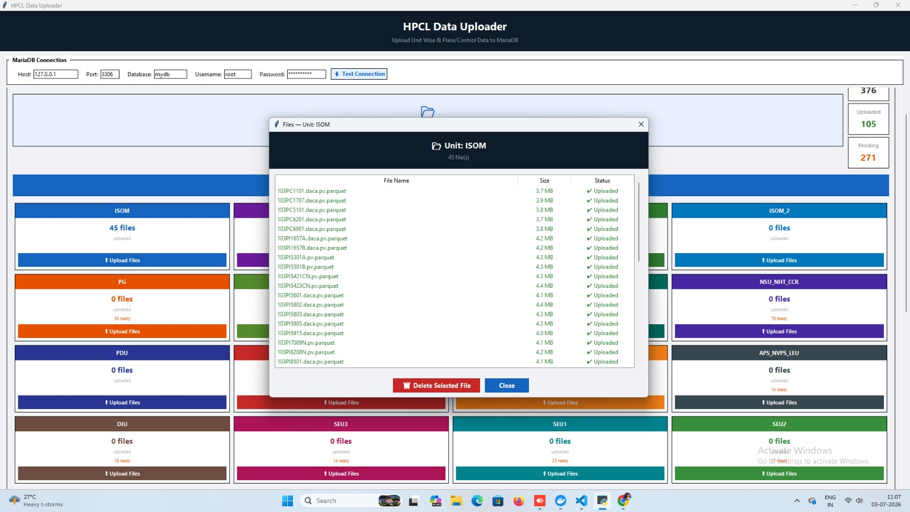
Database MariaDB – GUI

Slide 6
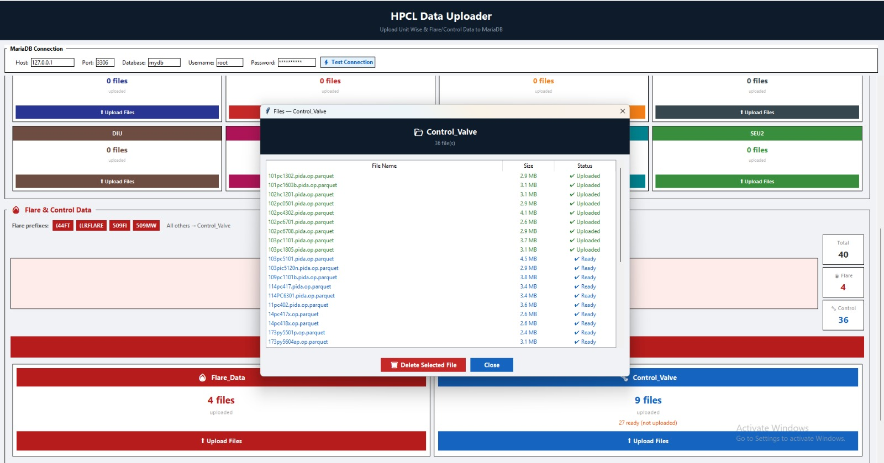
Database MariaDB – GUI

Slide 7
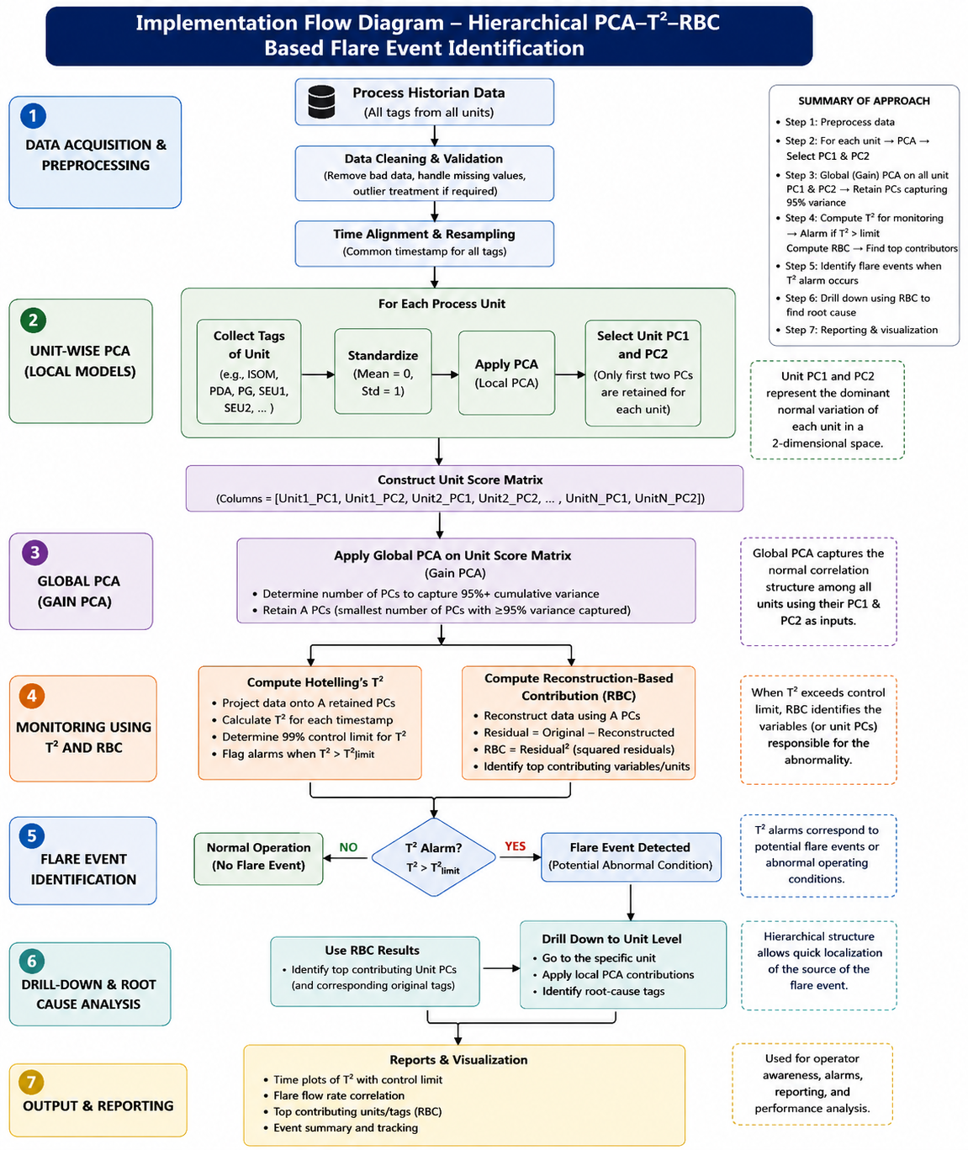

Slide 8
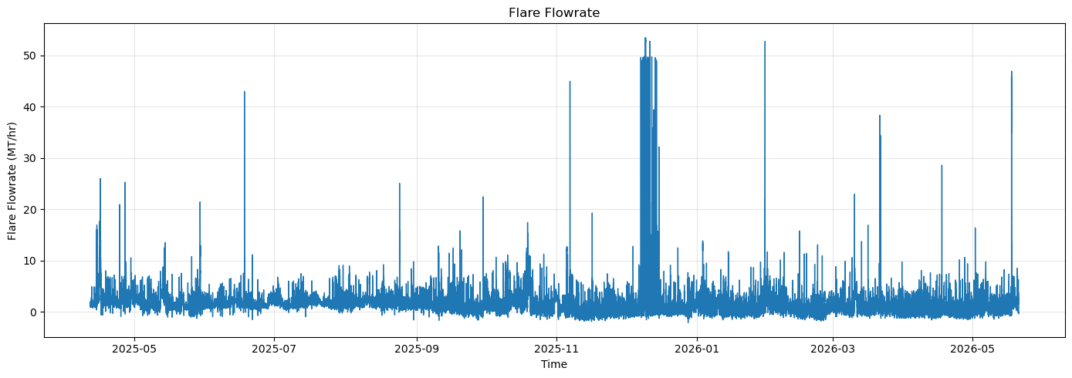
Flare flowrate

Slide 9
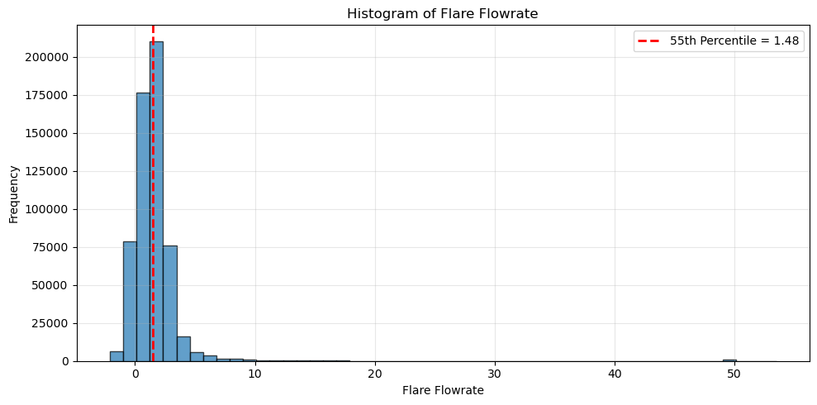

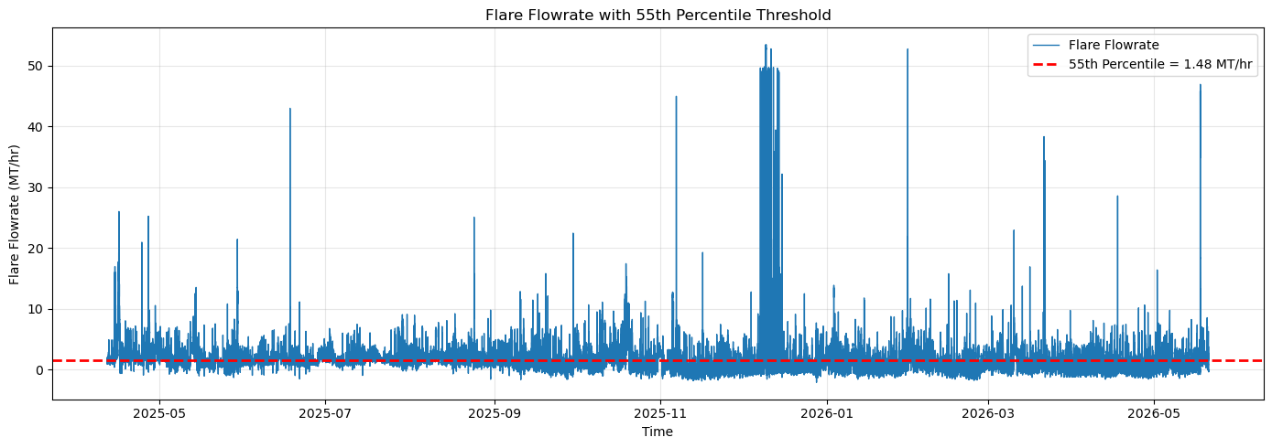
Flare flowrate

Slide 10



Flare flowrate

Slide 11
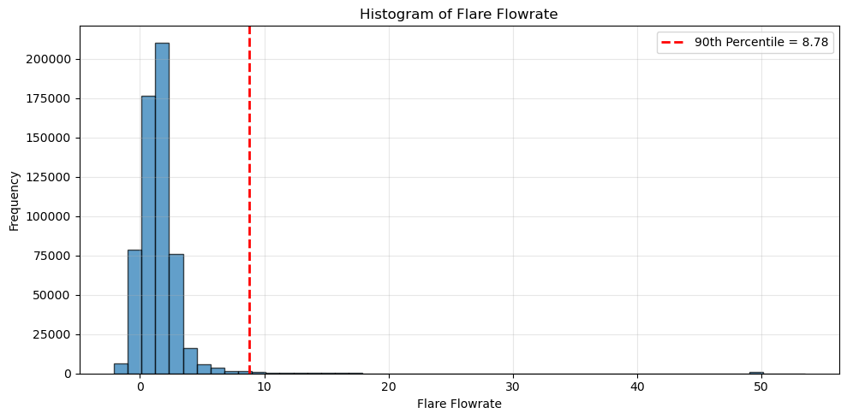


Flare flowrate

Slide 12
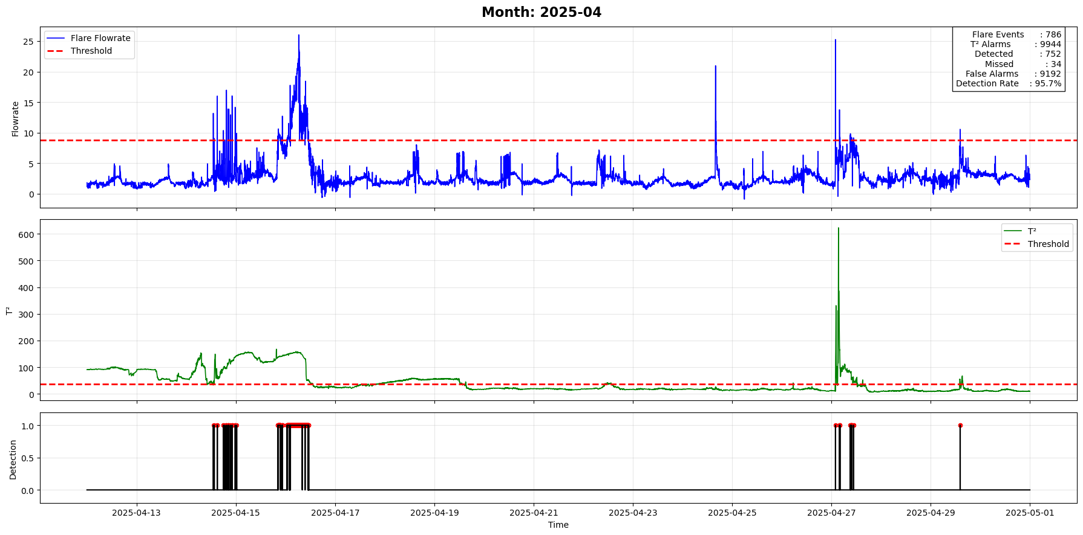
Final results

Slide 13
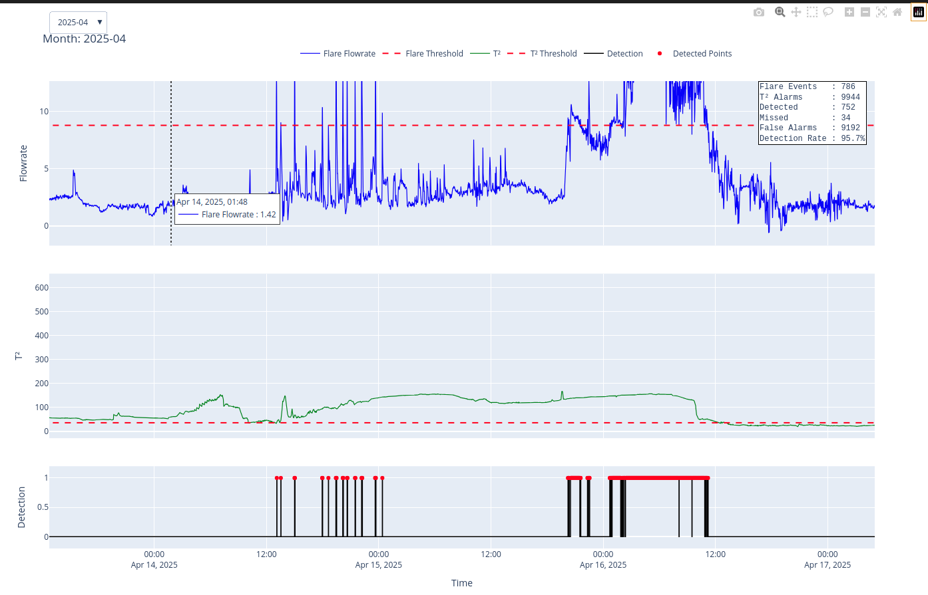
Final results

Slide 14
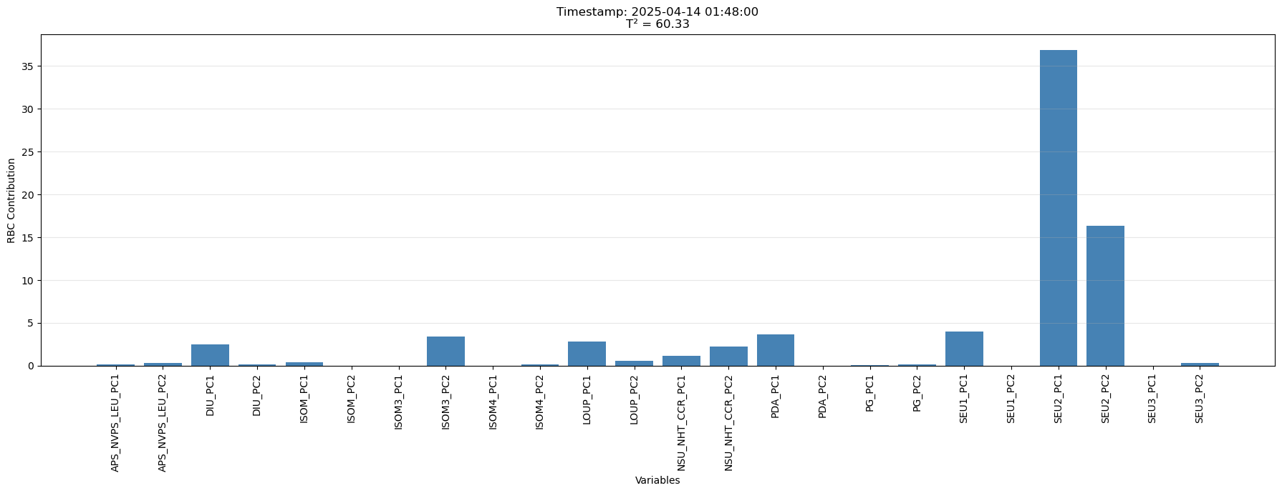
Final results

Slide 15
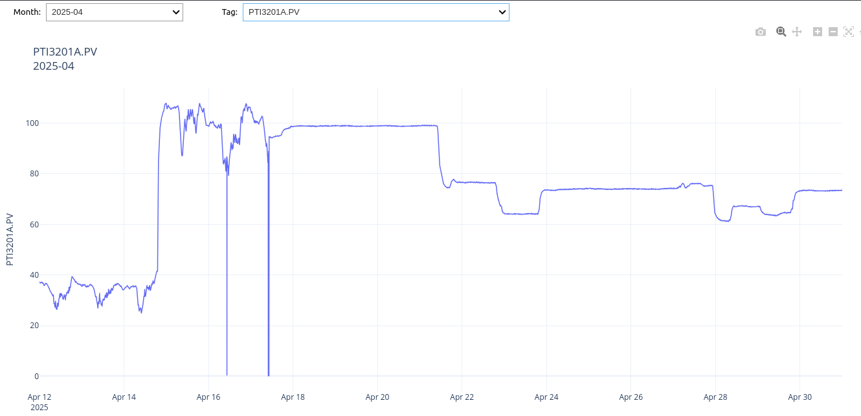
Final results

Slide 16
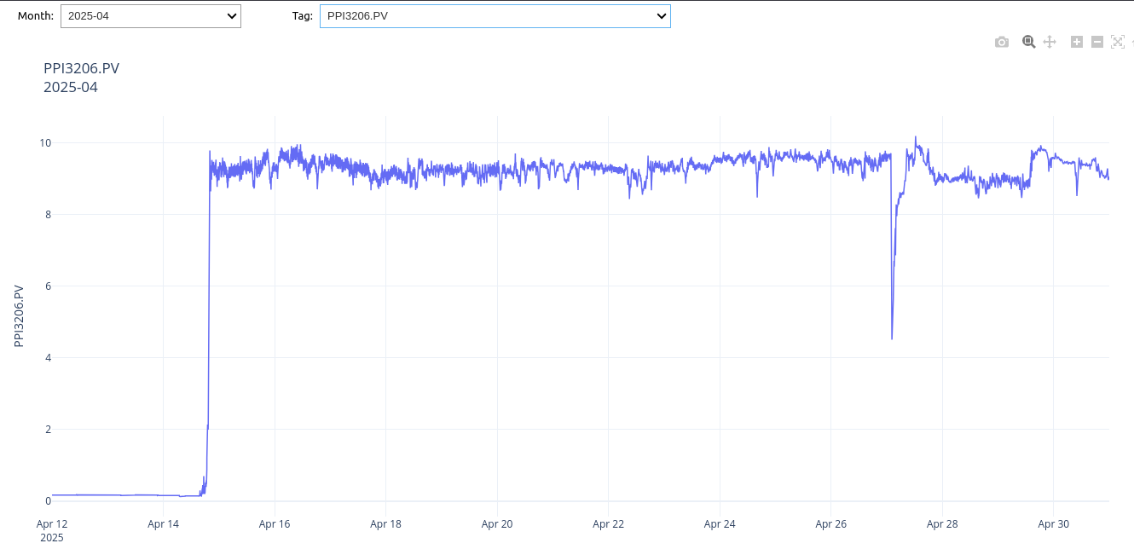
Final results

Slide 17
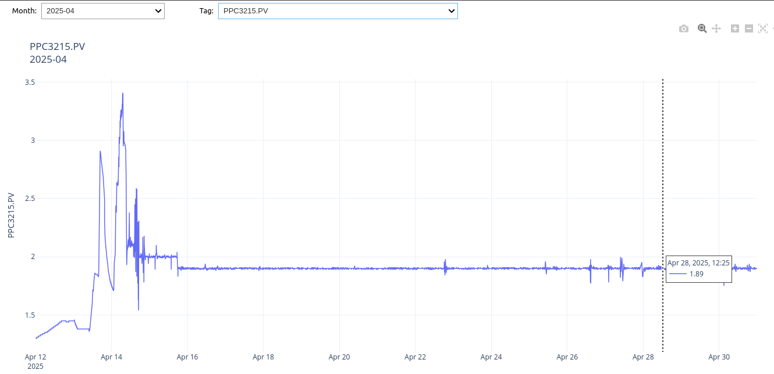
Final results

Slide 18
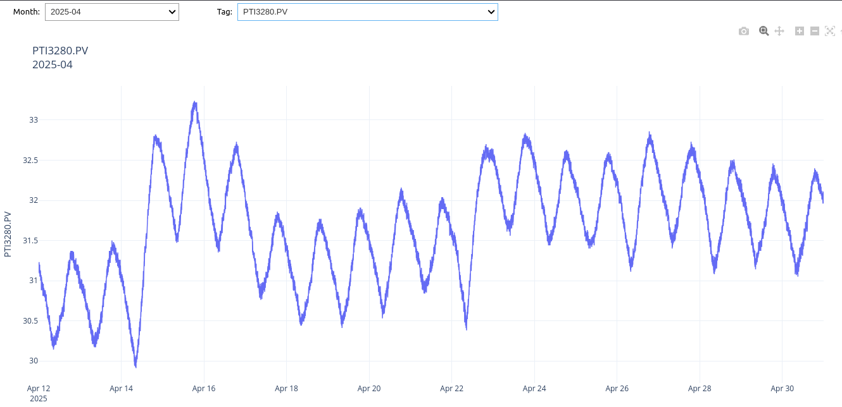
Final results

Slide 19
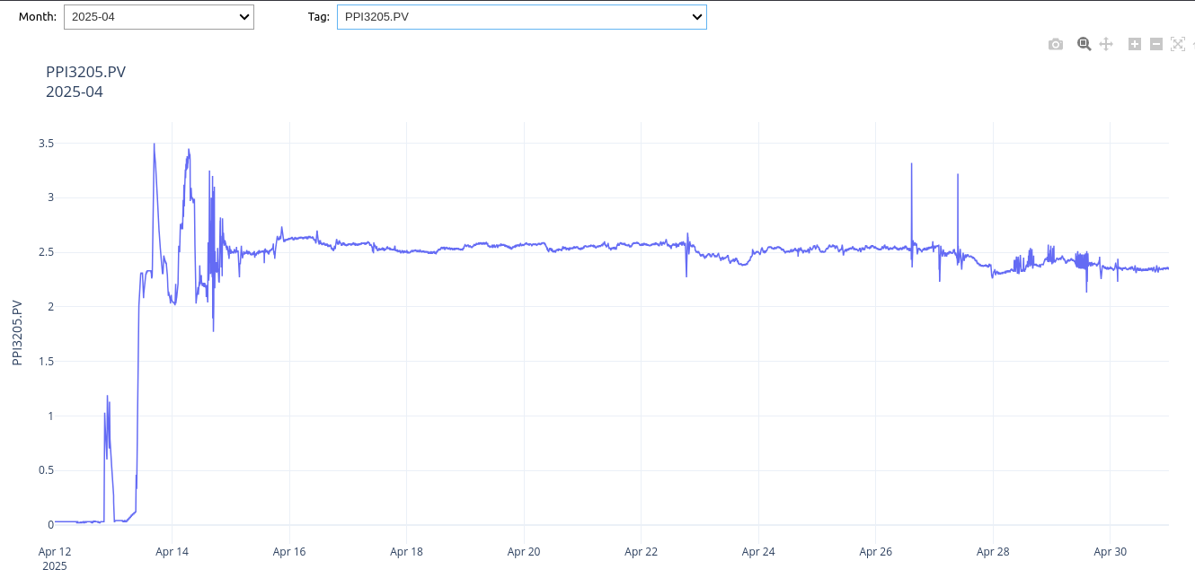
Final results

Slide 20
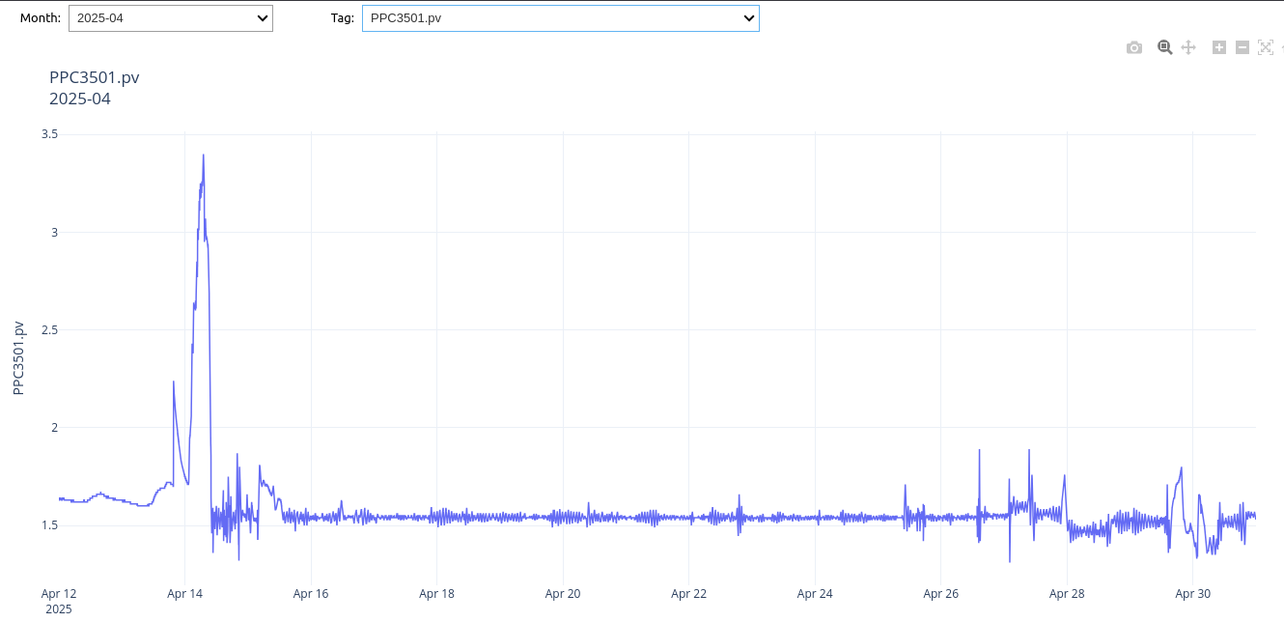
Final results

Slide 21
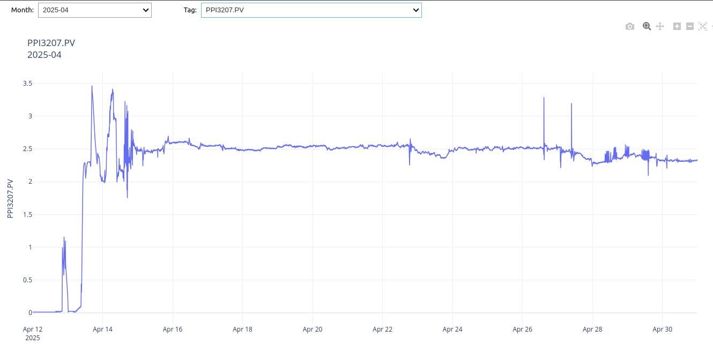
Final results

Slide 22
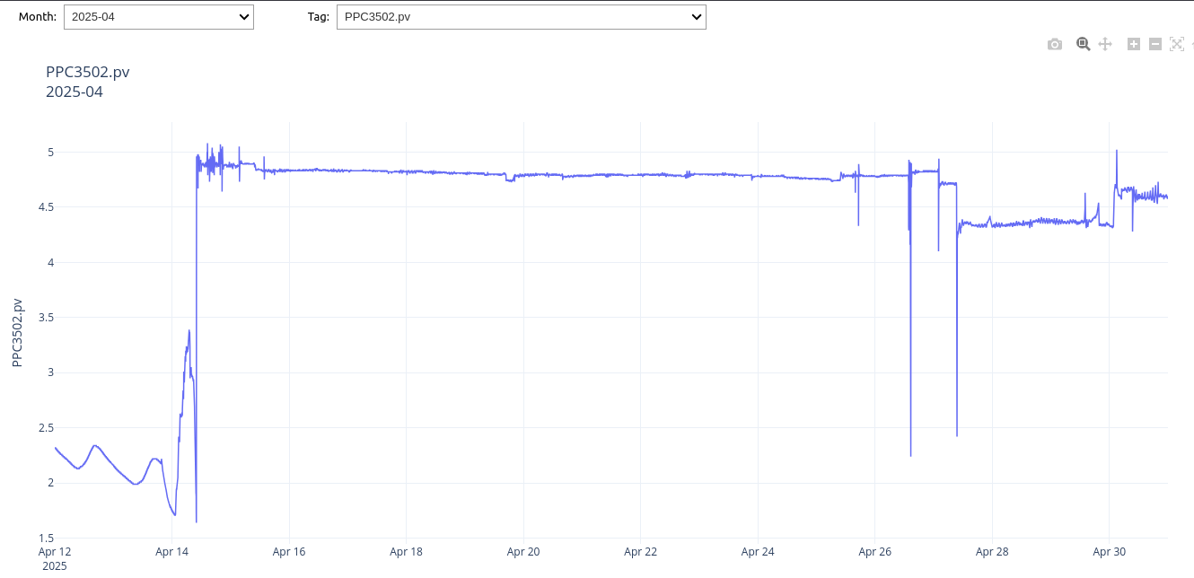
Final results

Slide 23
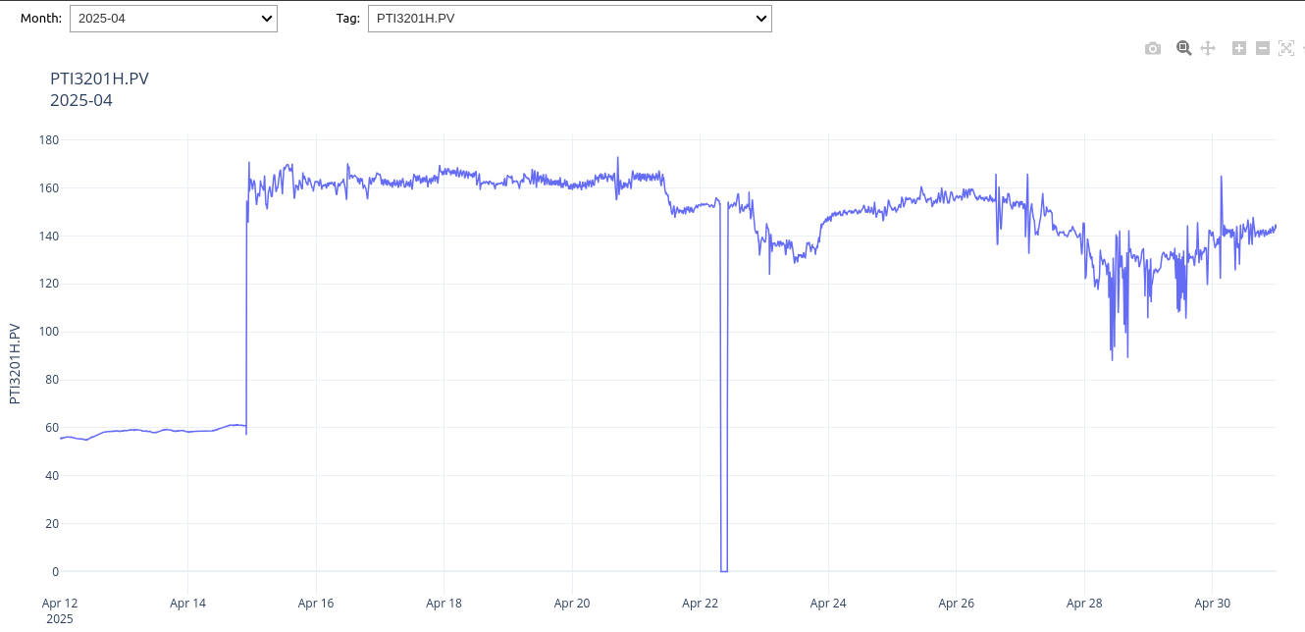
Final results

Slide 24
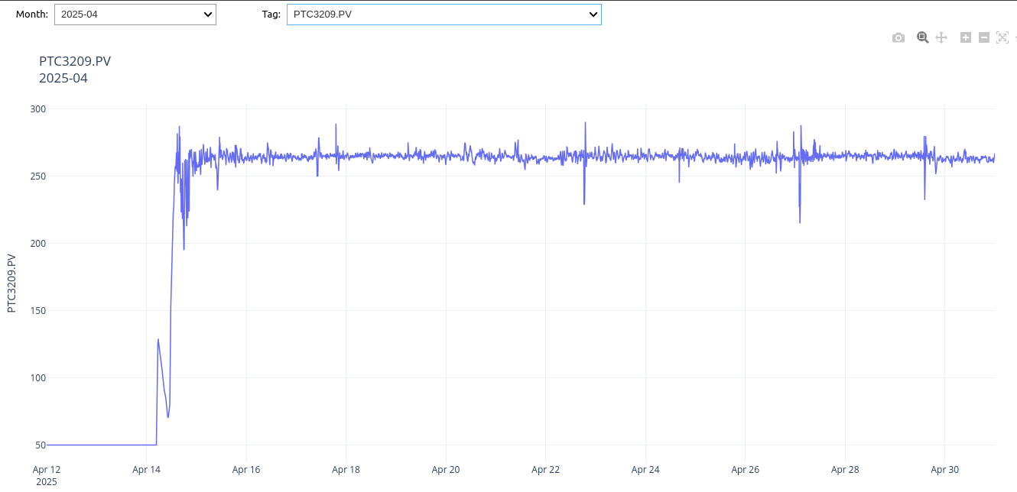
Final results

Slide 25
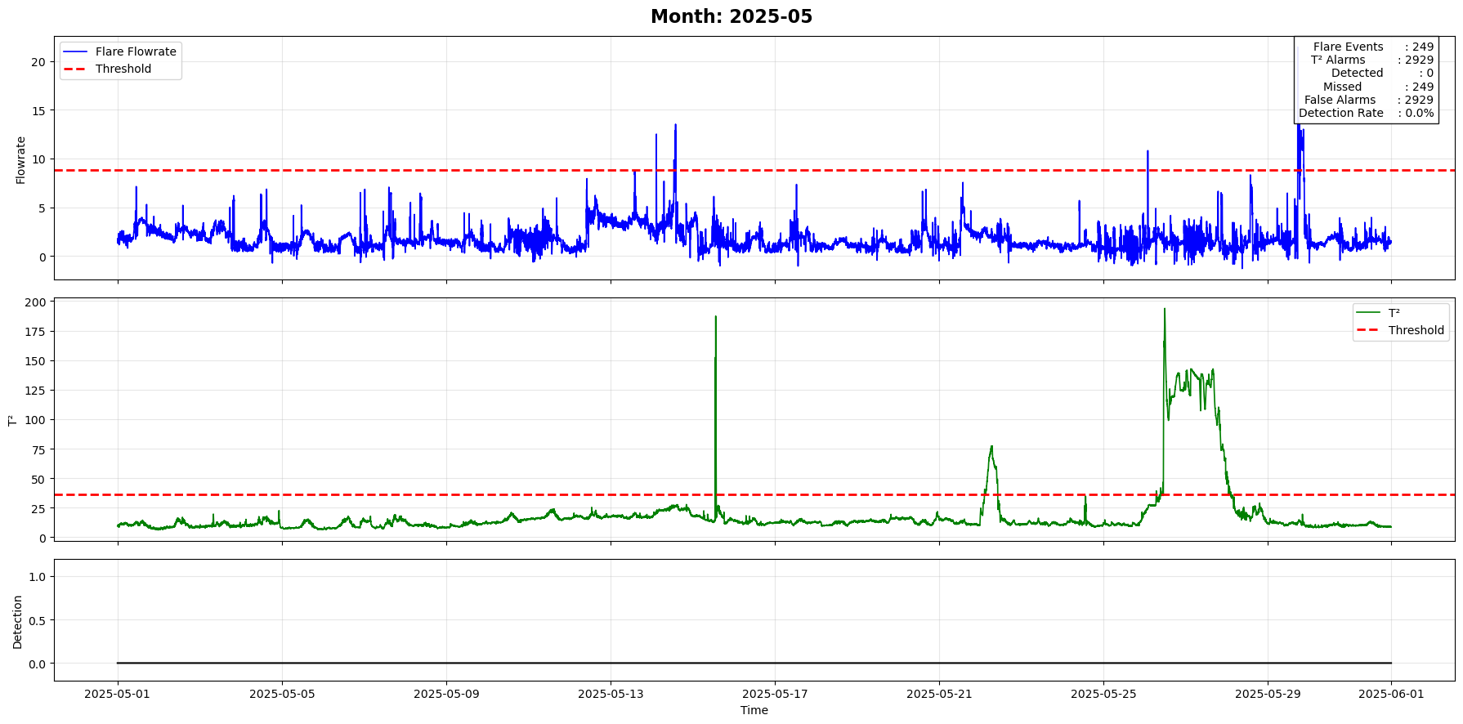
Final results

Slide 26
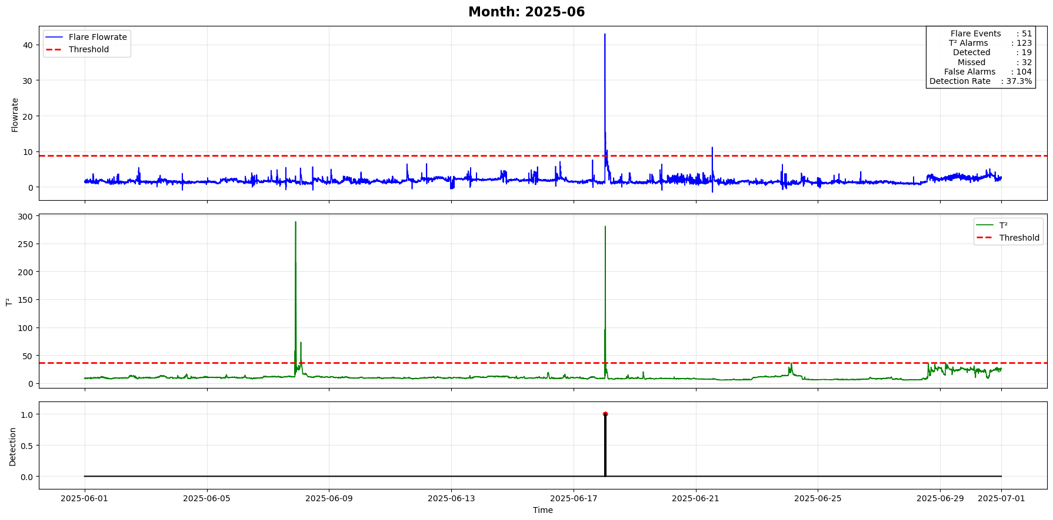
Final results

Slide 27
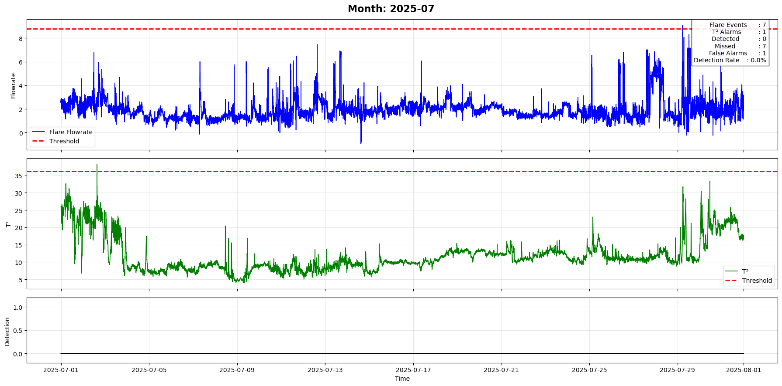
Final results

Slide 28
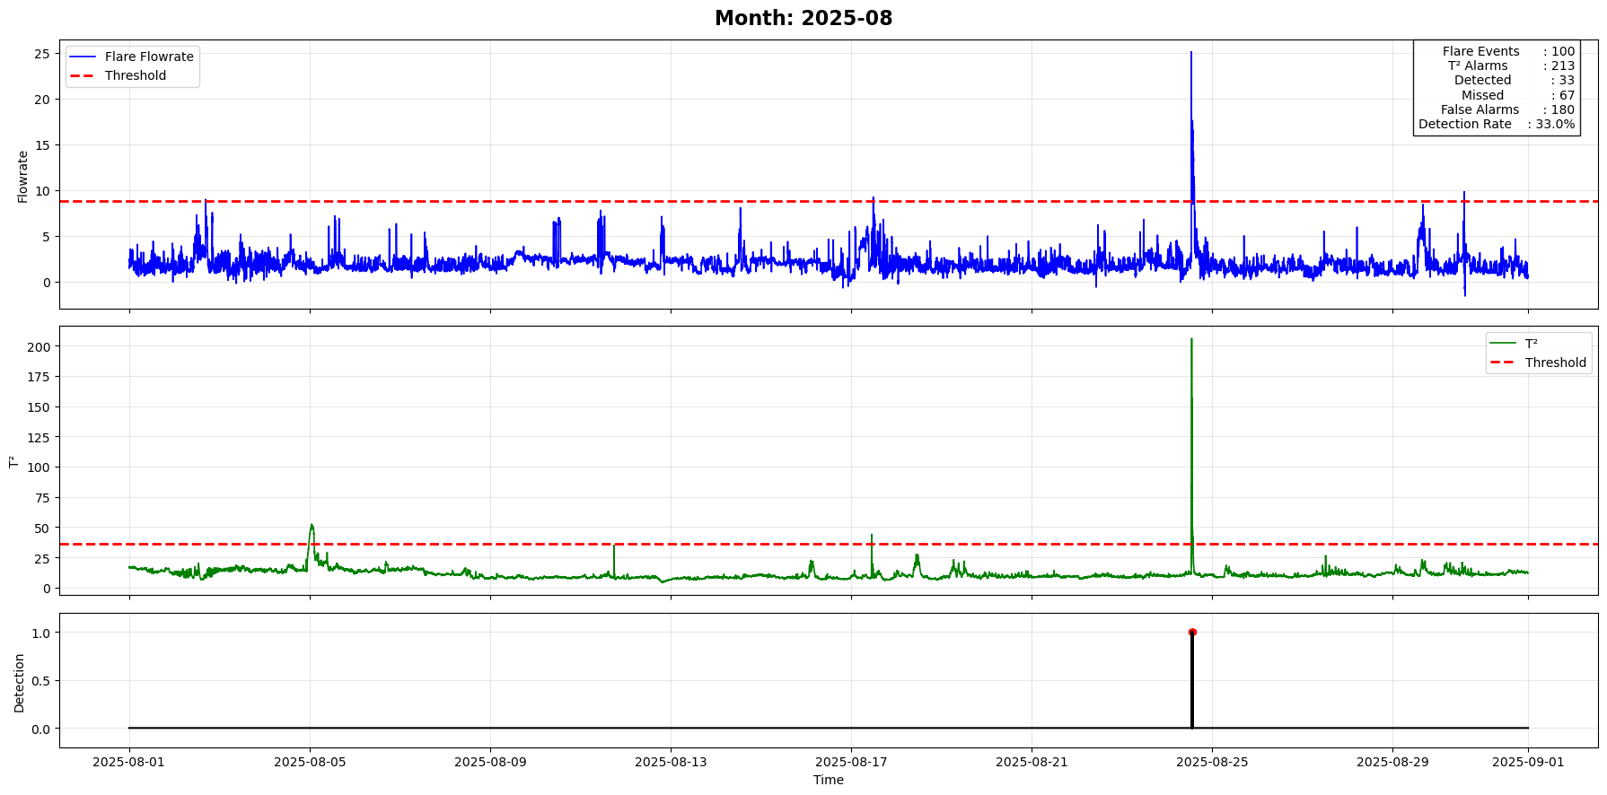
Final results

Slide 29
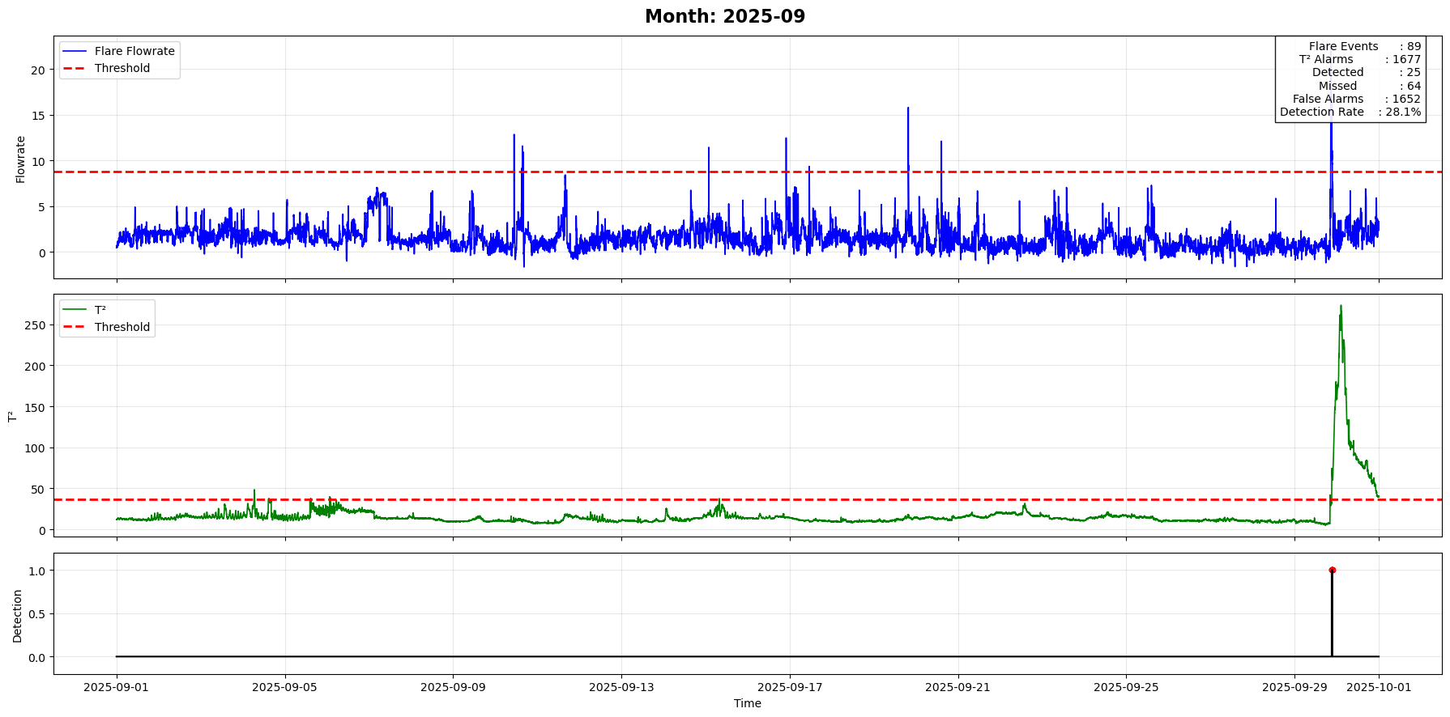
Final results

Slide 30
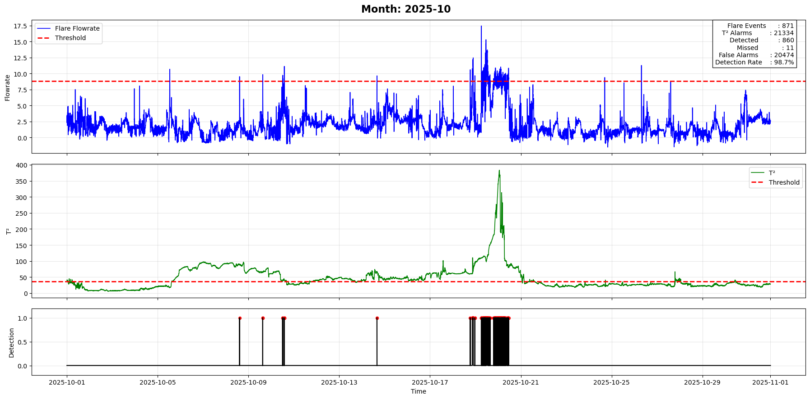
Final results

Slide 31
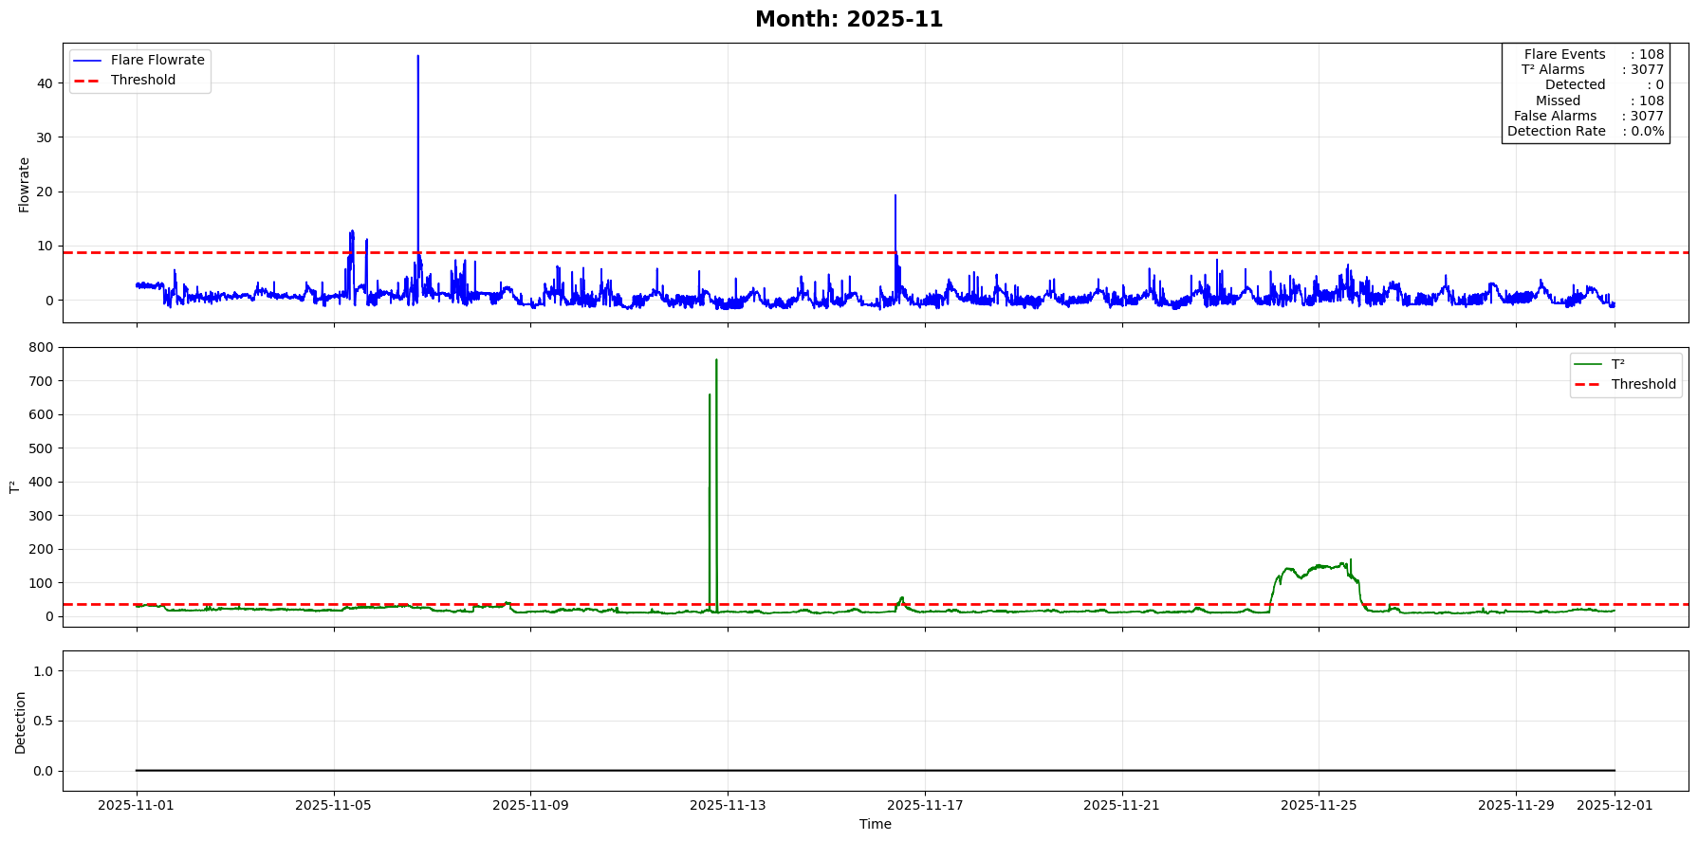
Final results

Slide 32
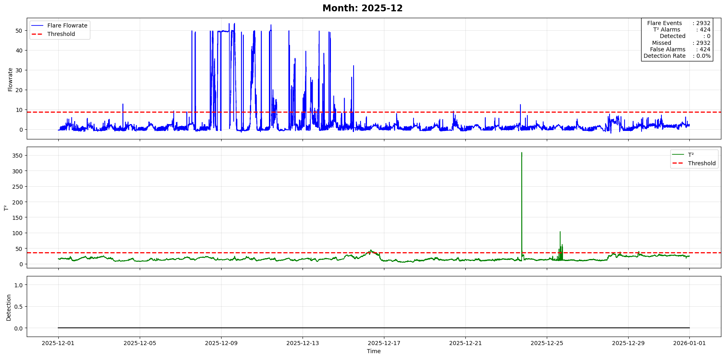
Final results

Slide 33
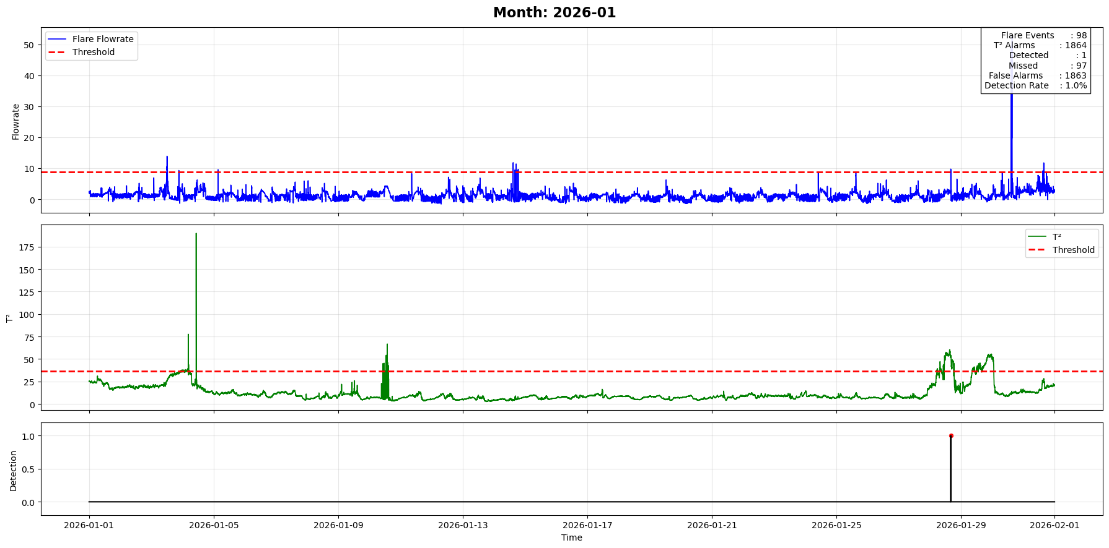
Final results

Slide 34
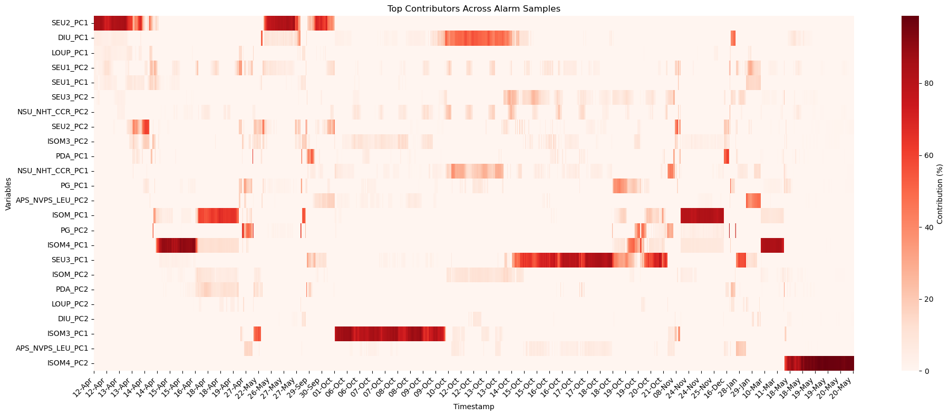
Final results

Slide 35
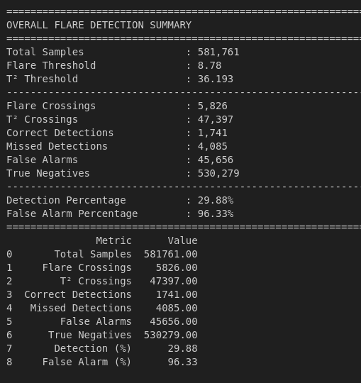
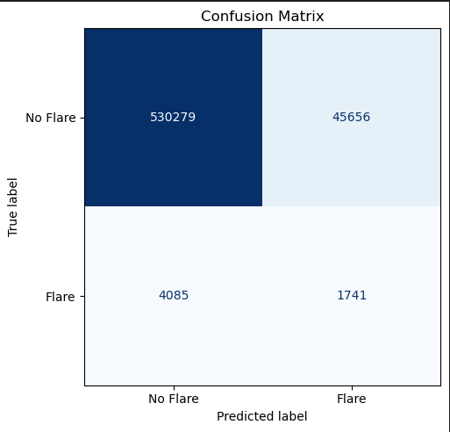
Summary

Slide 36
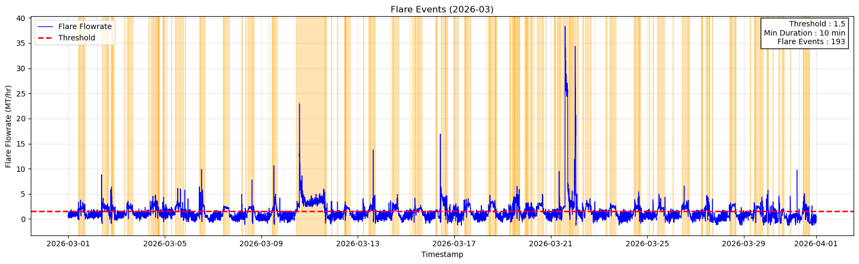
Flare period (Flare event)
Flare flowrate threshold is set to 1.5 MT/h.
A flare event starts when the flare flowrate exceeds the threshold.
The flowrate must remain above the threshold for at least 10 consecutive minutes.
A continuous above-threshold period is counted as one flare event.
The flare event ends when the flowrate falls below the threshold.

Slide 37
Detection Strategy
The Hotelling's T² statistic is used for flare detection.
A flare event is considered detected if T² exceeds its control limit at least once during the flare event period.
It is not necessary for T² to remain above the threshold throughout the entire flare event.
A single T² alarm within the flare event duration is sufficient to declare the event as detected.
If no T² alarm occurs during the flare event, it is classified as a missed detection.
Performance Evaluation
True Positive (TP): Flare event detected by at least one T² alarm.
False Negative (FN): Flare event with no T² alarm.
False Positive (FP): T² alarm occurring outside any flare event.
Detection Rate (%) = (Detected Flare Events / Total Flare Events) × 100.

Slide 38
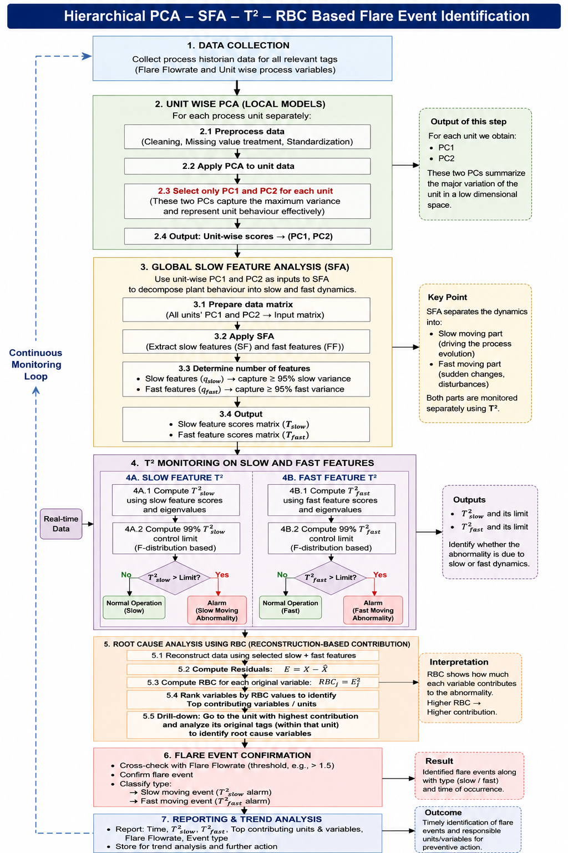

Slide 39
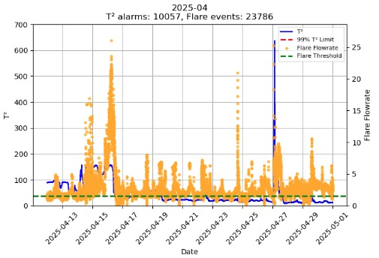
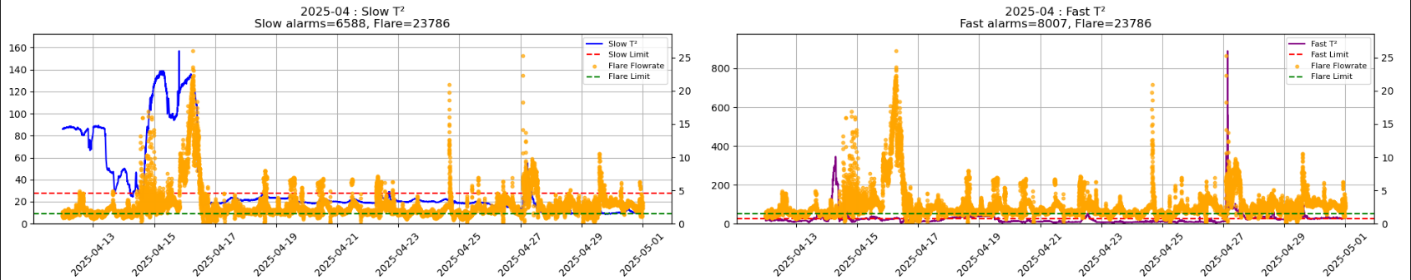
Final results (PCA-SFA)

Slide 40

Future work
Extend the batch approach to a moving-window framework and develop a prediction model incorporating lagged process variables.
Apply dynamic PCA

Slide 41
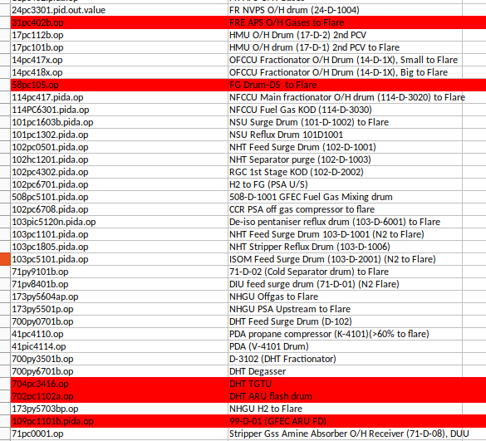
Doubt

Slide 42
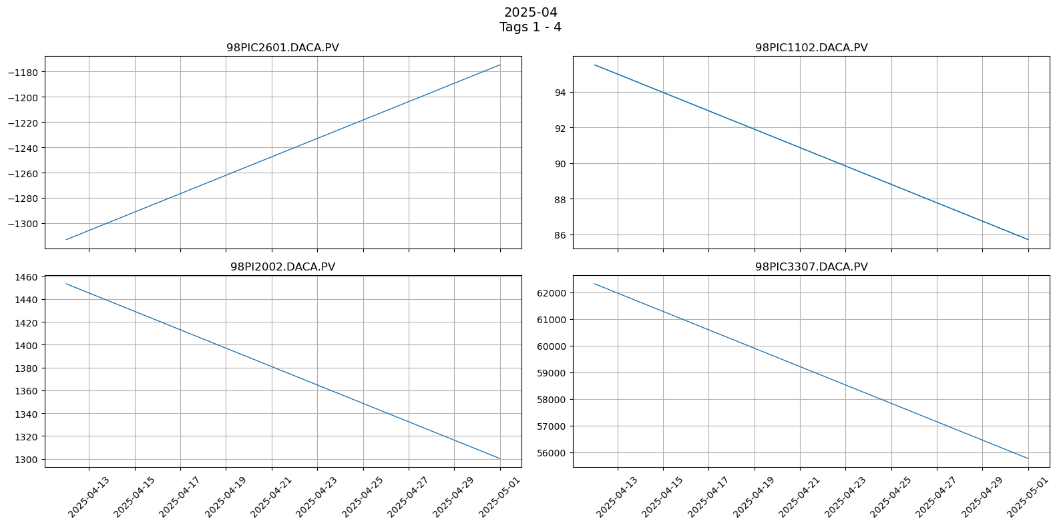
DAK unit

Slide 43
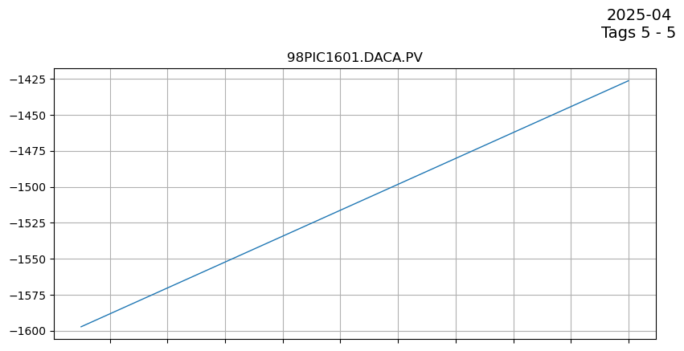
DAK unit

Slide 44
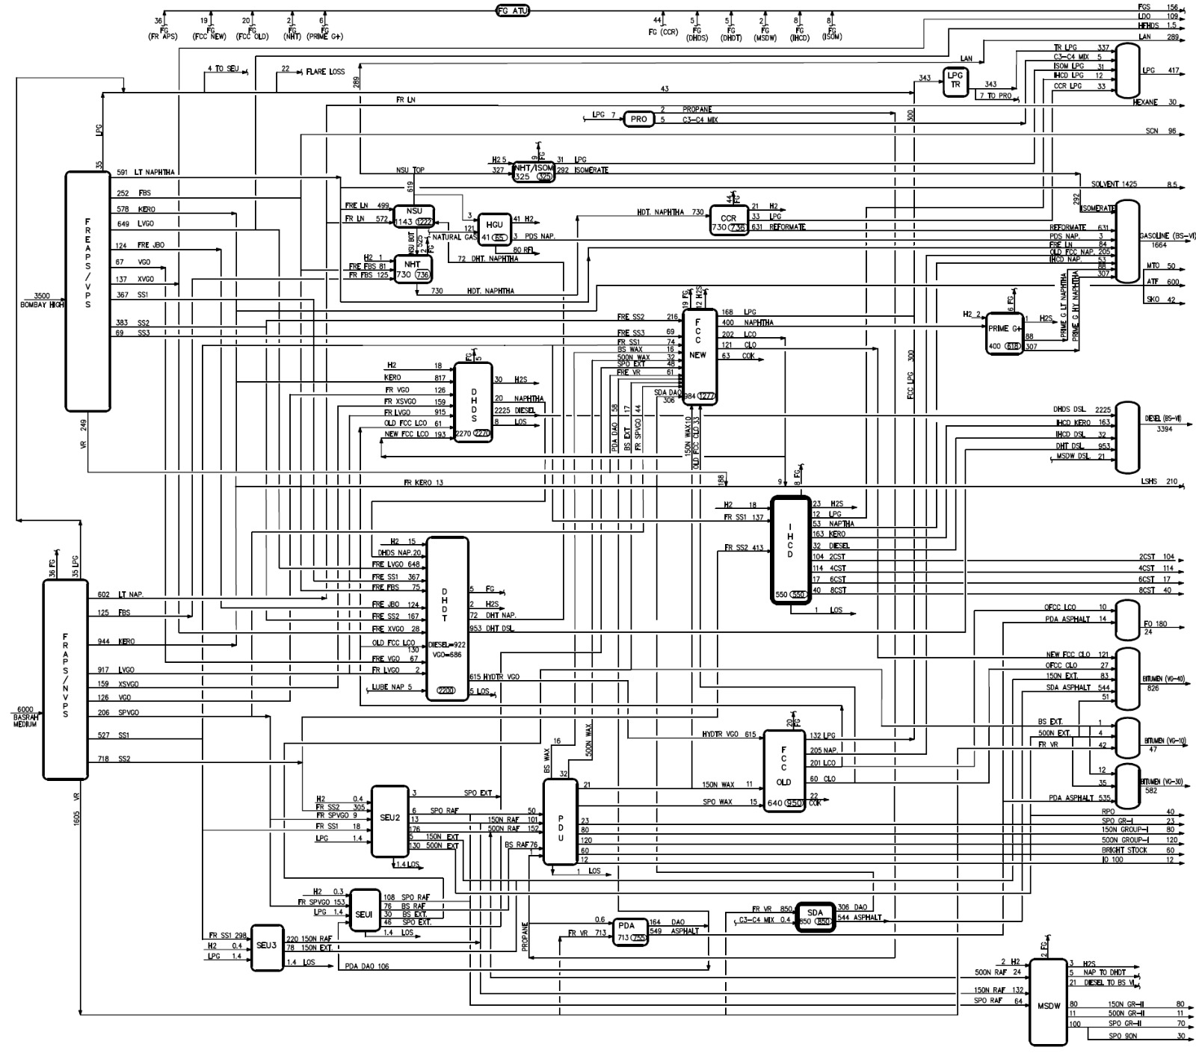
Flow diagram

Slide 45
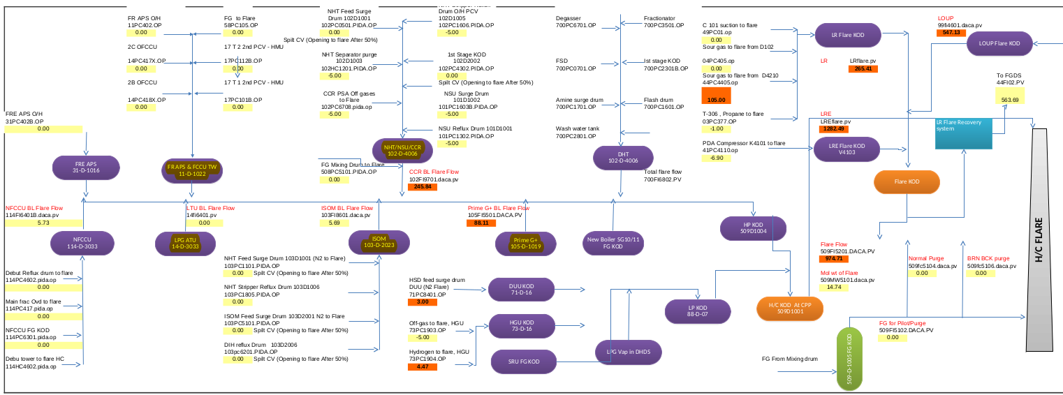
Flow diagram

Slide 46
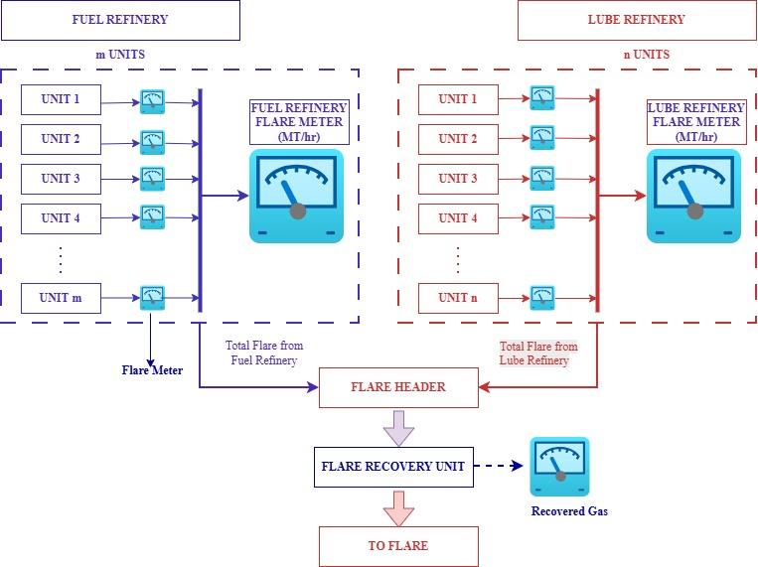
Flow diagram

Slide 47
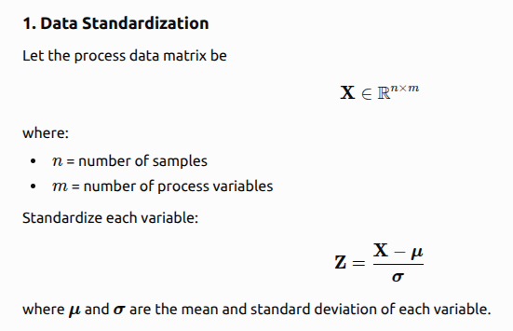
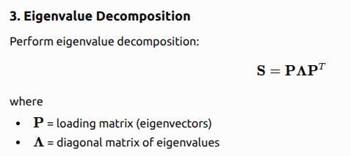
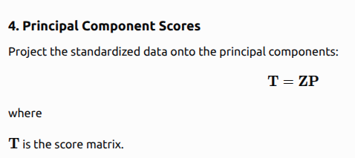
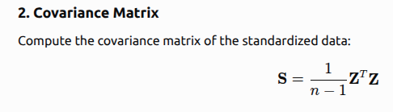
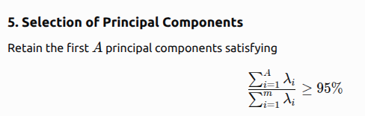
PCA

Slide 48
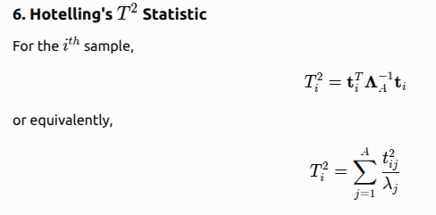


T² statistic

Slide 49



Reconstruction based contribution

